Slide 1
Chapter 7: Microarchitecture
Pipelined Performance

Slide 2
Pipelined Processor Performance Example
SPECINT2000 benchmark:
25% loads
10% stores
13% branches
52% R-type
Suppose:
40% of loads used by next instruction
50% of branches mispredicted
What is the average CPI? (Ideally it’s 1, but…)
CPI
Load CPI = 1 when not stalling, 2 when stalling
So, CPI_{lw} = 0.6 x 1 + 0.4 x 2 = 1.4
Branch CPI = 1 when branch not taken, 3 when mispredicting
So, CPI_{beq} = 0.5 x 1 + 0.5 x 3 = 2
Average CPI = (0.25)(1.4) + (0.1)(1) + (0.13)(2) + (0.52)(1) = 1.23

Slide 3
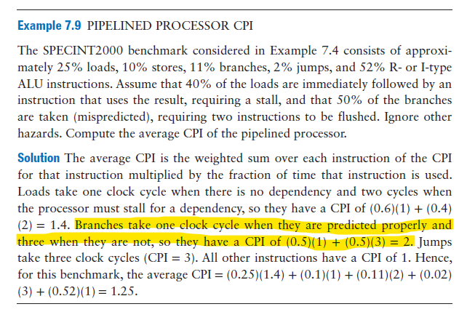
Branch CPI Calculation
Branch CPI = % of correctly predicted branches x 1cc
+ % of mispredicted branches x 3cc
= 0.5 x 1 + 0.5 x 3
Branch CPI = 2

Slide 4
Pipelined Performance Example
Program with 100 billion instructions
Program Execution Time=(# instructions) × CPI × T_{c}
= (100 × 10⁹)(1.23)(350 × 10⁻¹²)
= 43 seconds

Slide 5
Processor Performance Comparison
Processor | Execution Time (seconds) | Speedup (single-cycle as baseline)
Single-cycle | 75 | 1
Multicycle | 155 | 0.5
Pipelined | 43 | 1.7

Slide 6
Branch Prediction
Ideal pipelined processor: CPI = 1
Branch misprediction increases CPI
Static branch prediction:
Check direction of branch (forward or backward)
If backward, predict taken Unrealistic!
Else, predict not taken Unrealistic!
Dynamic branch prediction:
Keep history of last several hundred (or thousand) branches in branch target buffer, record:
Branch destination
Whether branch was taken

Slide 7
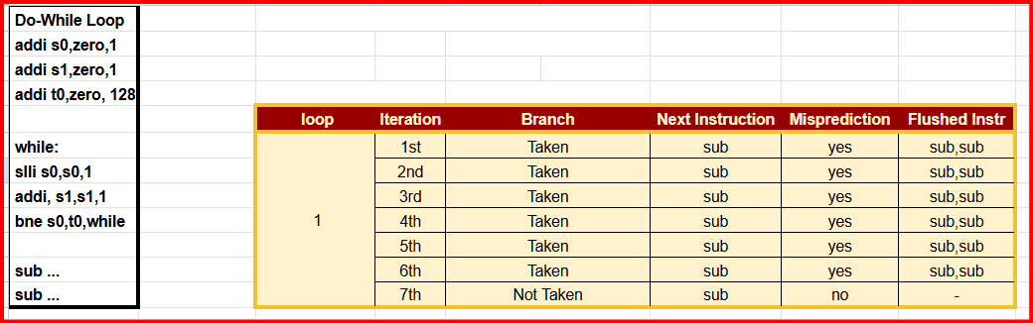
CPI Calculation Without Branch Prediction
Branch CPI = % of correctly predicted branches x 1cc
+ % of mispredicted branches x 3cc
= 1/7 x 1 + 6/7 x 3
Branch CPI = 2.71

Slide 8
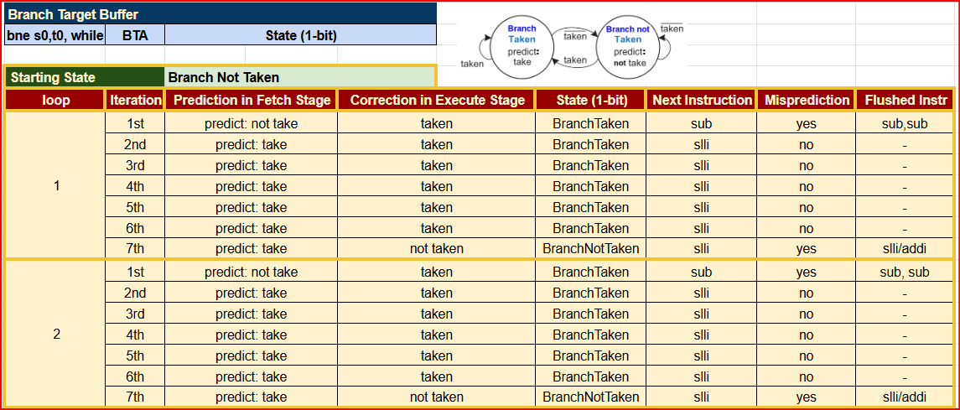
Dynamic 1-bit Branch Prediction
1-bit branch predictor
Starting State: Branch not Taken
Loop 1 is transient as state changing is settling down. Loop 2 onwards is the one more deterministic for CPI calculation
addi s0,zero,1
addi s1,zero,1
addi t0,zero, 128
while:
slli s0,s0,1
addi, s1,s1,1
bne s0,t0,while
sub ...
sub ...

Slide 9
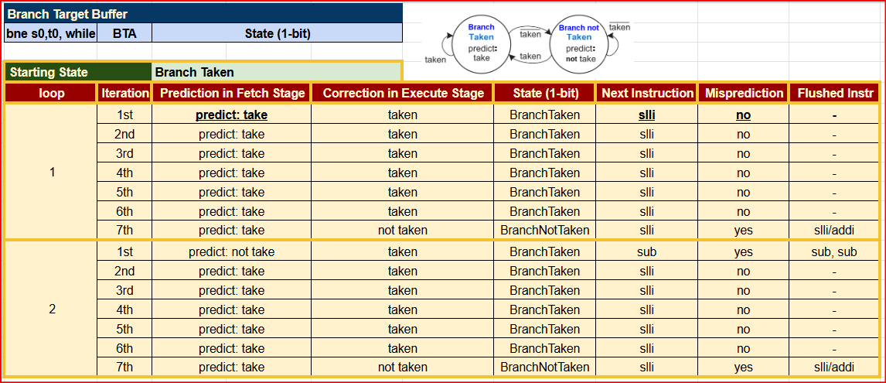
Dynamic 1-bit Branch Prediction
1-bit branch predictor
Starting State: Branch Taken
Loop 1 is transient as state changing is settling down. Loop 2 onwards is the one more deterministic for CPI calculation
addi s0,zero,1
addi s1,zero,1
addi t0,zero, 128
while:
slli s0,s0,1
addi, s1,s1,1
bne s0,t0,while
sub ...
sub ...

Slide 10
CPI Calculation with 1-bit Branch Prediction
Let's consider stable loops ie Loop 2 onwards
Any starting state in Loop 1 will not affect
Branch CPI = % of mispredicted branches x 3cc
+ % of correctly predicted branches x 1cc
Branch CPI = 2/7 x 3cc + 5/7 x 1
= 1.57

Slide 11
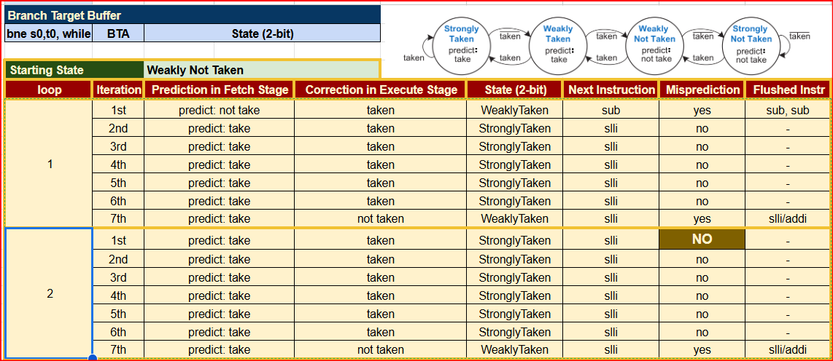
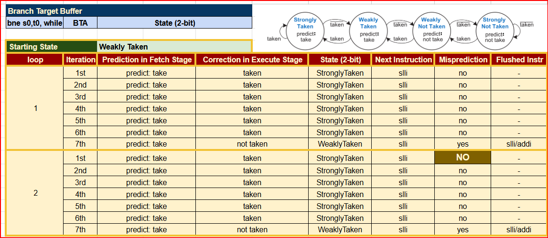
Dynamic 2-bit Branch Prediction
2-bit branch predictor
Starting State: Weakly Not Taken or Weakly Taken
addi s0,zero,1
addi s1,zero,1
addi t0,zero, 128
while:
slli s0,s0,1
addi, s1,s1,1
bne s0,t0,while
sub ...
sub ...

Slide 12
CPI Calculation with 2-bit Branch Prediction
Let's consider stable loops ie Loop 2 onwards
Any starting state in Loop 1 will not affect
Branch CPI = % of mispredicted branches x 3cc
+ % of correctly predicted branches x 1cc
Branch CPI = 1/7 x 3cc + 6/7 x 1
= 1.28

Slide 13
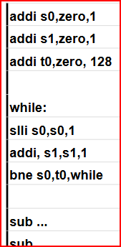
Total CPI for do-while loop with 2-bit Branch Prediction
Total CPI =
% of R/I-Type Instr. x CPI of R-Type Instr. + % of B-Type Instr. x CPI of B-Type Instr.
% of R/I-Type Instr. = [ 2 x (3 addi+2 sub) + 2 x 7 x (1 slli + 1 addi) ]______
[ 2 x (3 addi+2 sub) + 2 x 7 x (1 slli + 1 addi) ] + [ 2 x 7 x (1 bne)]
= 38/(38+14)=0.73
% of B-Type Instr. = [ 2 x 7 x (1 bne)]___________
[ 2 x (3 addi+2 sub) + 2 x 7 x (1 slli + 1 addi) ] + [ 2 x 7 x (1 bne)]
= 14/(38+14)=0.269
Total CPI =
% of R/I-Type Instr. x CPI of R/I-Type Instr. + % of B-Type Instr. x CPI of B-Type Instr.
0.73 x 1 + 0.269 x 1.28=1.1
L L I L I

Slide 14
Total CPI for do-while loop with 1-bit Branch Prediction
Total CPI =
% of R/I-Type Instr. x CPI of R-Type Instr. + % of B-Type Instr. x CPI of B-Type Instr.
% of R/I-Type Instr. = [ 2 x (3 addi+2 sub) + 2 x 7 x (1 slli + 1 addi) ]______
[ 2 x (3 addi+2 sub) + 2 x 7 x (1 slli + 1 addi) ] + [ 2 x 7 x (1 bne)]
% of B-Type Instr. = [ 2 x 7 x (1 bne)]___________
[ 2 x (3 add+2 sub) + 2 x 7 x (1 slli + 1 addi) ] + [ 2 x 7 x (1 bne)]
Total CPI =
% of R/I-Type Instr. x CPI of R/I-Type Instr. + % of B-Type Instr. x CPI of B-Type Instr.
0.73 x 1 + 0.269 x 1.57=1.19
L L I L I

Slide 15
Total CPI for do-while loop without Branch Prediction
Total CPI =
% of R/I-Type Instr. x CPI of R-Type Instr. + % of B-Type Instr. x CPI of B-Type Instr.
% of R/I-Type Instr. = [ 2 x (3 add+2 sub) + 2 x 7 x (1 slli + 1 addi) ]______
[ 2 x (3 add+2 sub) + 2 x 7 x (1 slli + 1 addi) ] + [ 2 x 7 x (1 bne)]
% of B-Type Instr. = [ 2 x 7 x (1 bne)]___________
[ 2 x (3 add+2 sub) + 2 x 7 x (1 slli + 1 addi) ] + [ 2 x 7 x (1 bne)]
Total CPI =
% of R/I-Type Instr. x CPI of R/I-Type Instr. + % of B-Type Instr. x CPI of B-Type Instr.
0.73 x 1 + 0.269 x 2.71=1.53
L L I L I

Slide 16
Pipelined Performance Example
Program with 52 instructions
Program Execution Time=(# instructions) × CPI × T_{c}
= (52)(1.53)(350 × 10⁻¹²)
= 27.84 nano seconds
Program Execution Time=(# instructions) × CPI × T_{c}
= (52)(1.19)(350 × 10⁻¹²)
= 21.65 nano seconds
Program Execution Time=(# instructions) × CPI × T_{c}
= (52)(1.1)(350 × 10⁻¹²)
= 20.02 nano seconds
without BP
with 1-bit BP
with 2-bit BP

Slide 17
